Slide 1
MODULE 13: EYE INJURIES
TCCC TIER 1
All Service Members
TCCC TIER 2
Combat Lifesaver
TCCC TIER 3
Combat Medic/Corpsman
TCCC TIER 4
Combat Paramedic/Provider

Slide 2





TACTICAL COMBAT CASUALTY CARE (TCCC) ROLE-BASED TRAINING SPECTRUM
ROLE 1 CARE
NONMEDICAL PERSONNEL
MEDICAL PERSONNEL
ASM
CMC
CPP
CLS
YOU ARE HERE
STANDARDIZED JOINT CURRICULUM
2

Slide 3
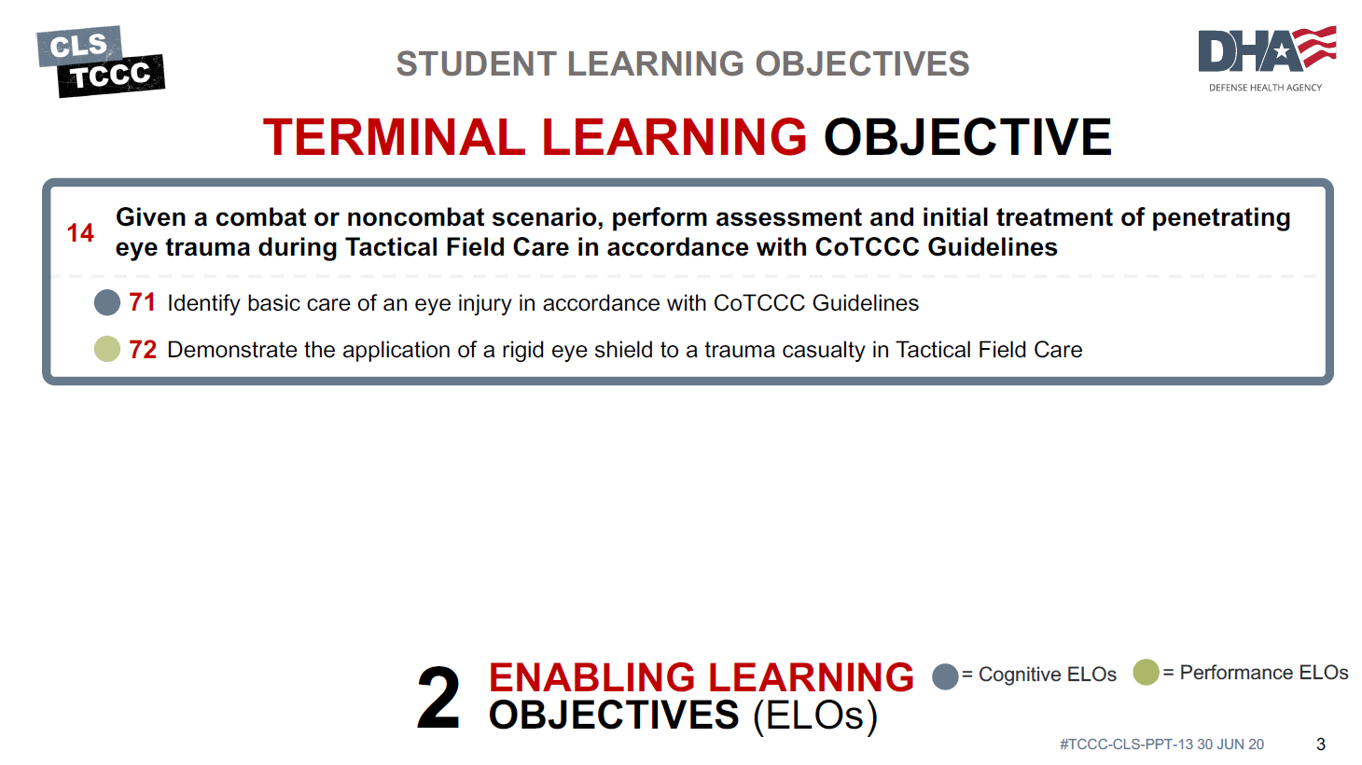

Slide 4


Three PHASES of TCCC
TACTICAL FIELD CARE
1 CARE UNDER FIRE
RETURN FIRE AND TAKE COVER
Quick decision-making:
▪ Consider scene safety
▪ Identify and control life- threatening bleeding
▪ Move casualty to safety
TACTICAL FIELD CARE
COVER AND CONCEALMENT
₃ TACTICAL EVACUATION CARE
More deliberate assessment and treatment of unrecognized
life-threatening injuries
▪ Pre-evacuation procedures
▪ Continuation of documentation
NOTE: This is covered in more advanced TCCC training!
2
Basic management plan:
Maintain tactical situational awareness
Triage casualties as required
Conduct MARCH PAWS
assessment
▪
▪
YOU ARE HERE
4
#TCCC-CLS-PPT-13 30 JUN 20

Slide 5
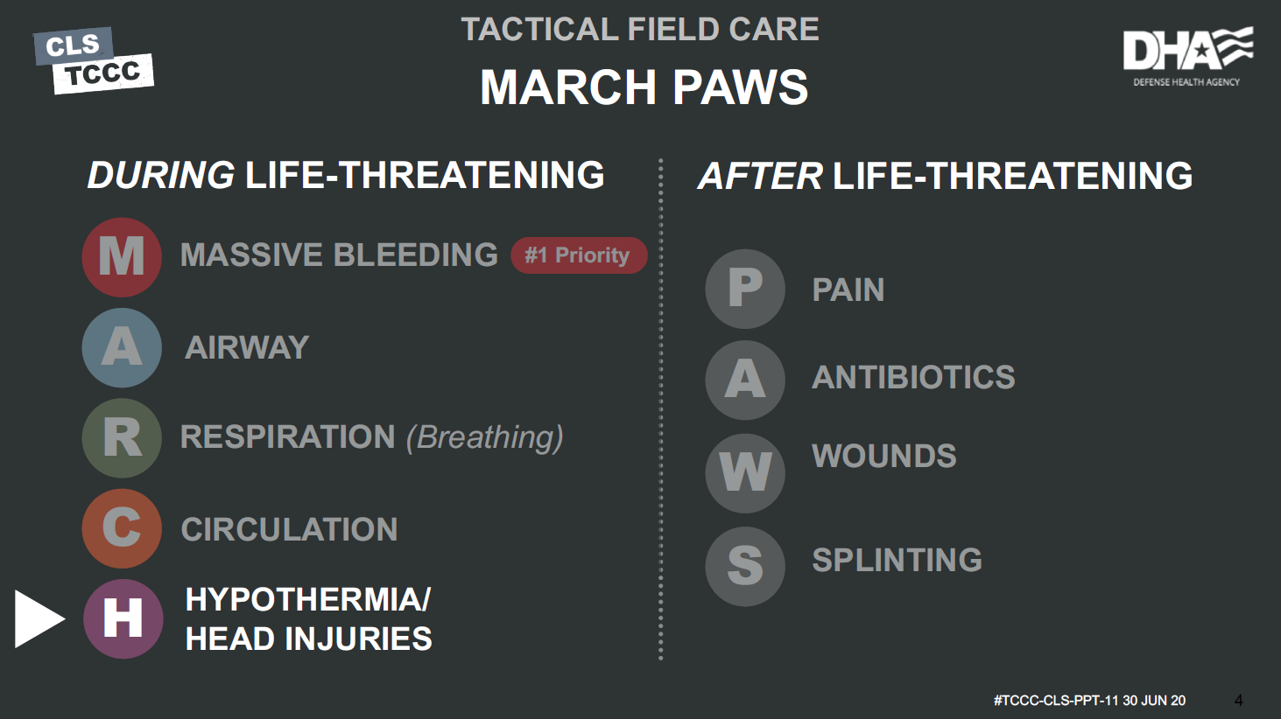
AFTER LIFE-THREATENING
PAIN
#TCCC-CLS-PPT-13 30 JUN 20

Slide 6


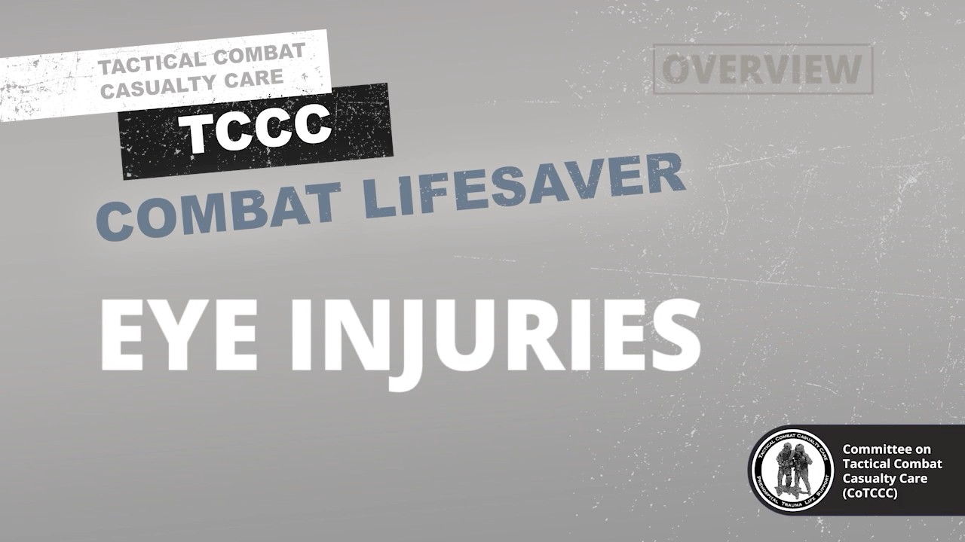
EYE INJURIES
EYE INJURIES OVERVIEW
Video can be found on DeployedMedicine.com

Slide 7

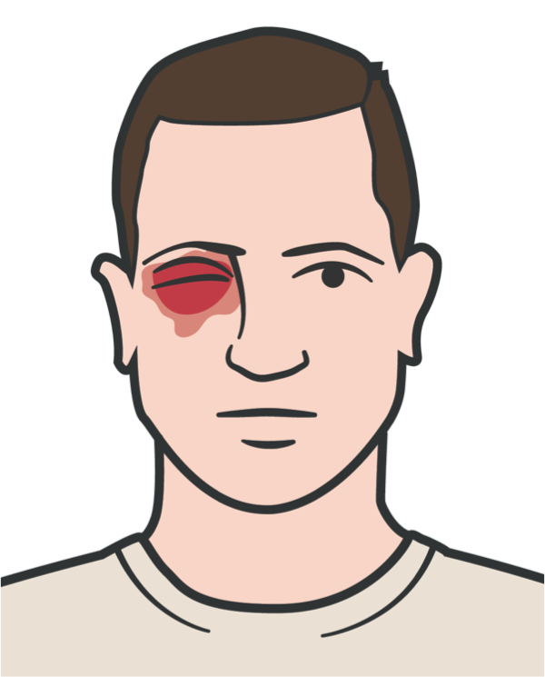
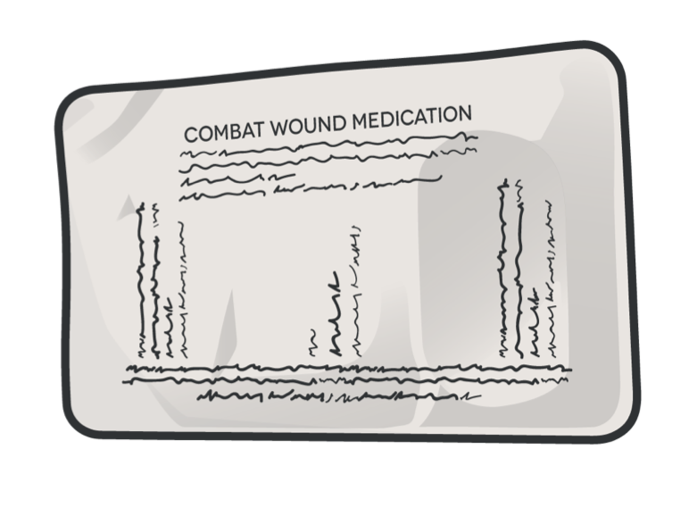
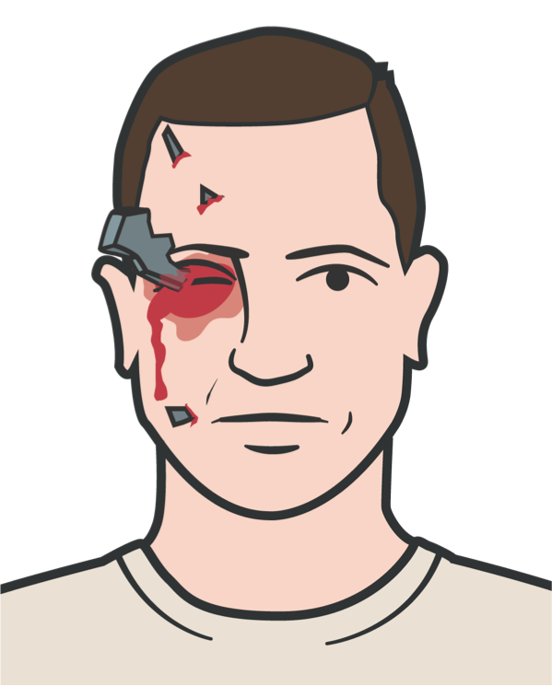

WHEN TO SUSPECT A PENETRATING EYE INJURY
EYE INJURIES
1
2
3
4
5
6
7
Bleeding surrounding the eye, inside the eyeball; or coming from the eyeball
Obvious penetration of shrapnel or debris into the eyeball or eye socket
Protruding objects from the globe of the eyeball
Swelling or lacerations of the globe of the eyeball
Protrusion of the globe of the eyeball from the eye socket
Reduced vision and swelling of the eye area
Misshapen or distorted parts of the eye

Slide 8
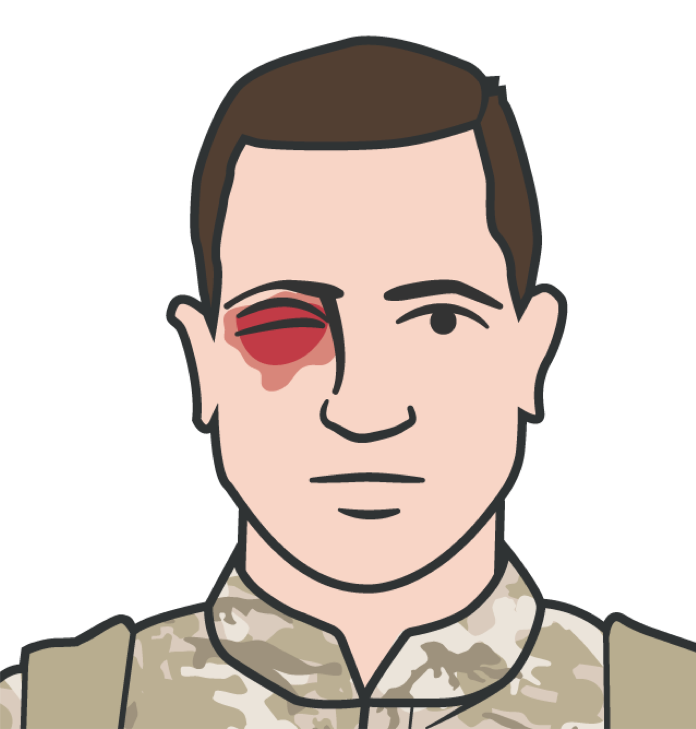
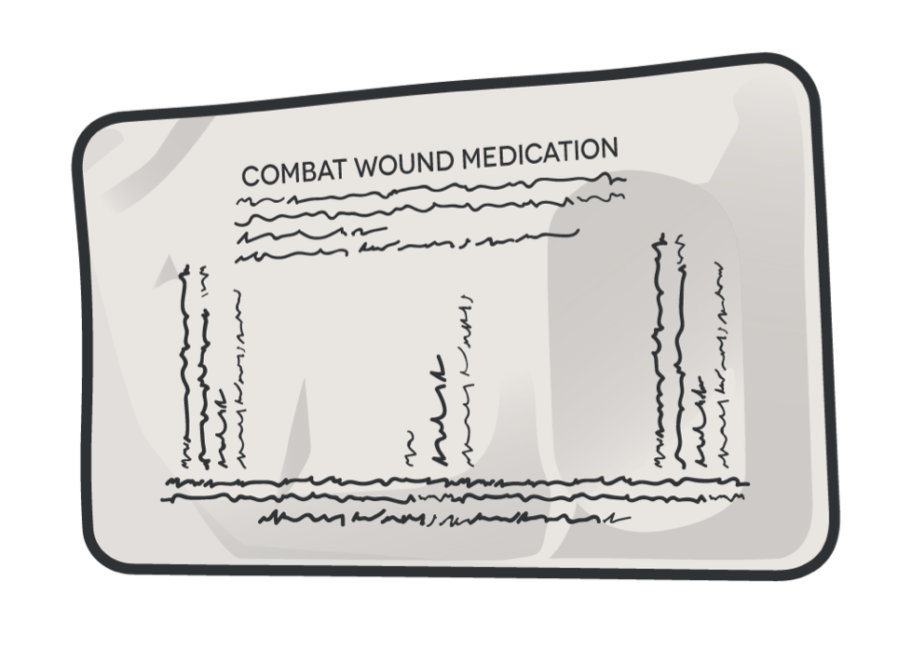
IF A PENETRATING EYE INJURY IS NOTED OR SUSPECTED
EYE INJURIES
1
Perform a rapid field test of visual acuity and document findings
2
Cover the affected eye with a rigid eye shield (NOT a pressure patch)
3
Administer the casualty’s complete Combat Wound Medication Pack (CWMP), all the medications contained
Remember:
All treatments performed must be documented in the casualty’s DD Form 1380

Slide 9

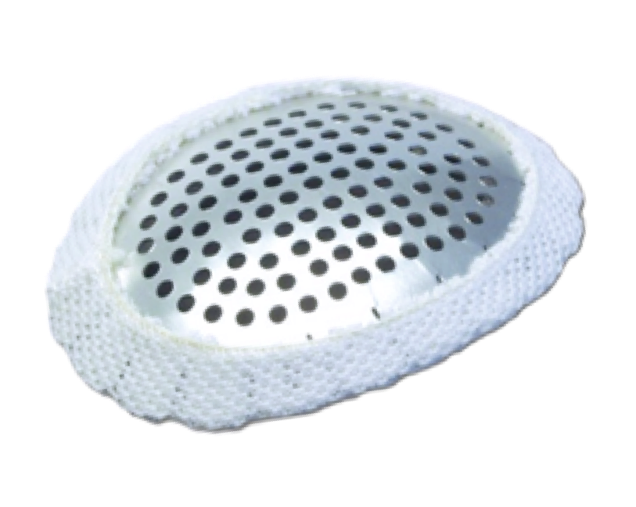
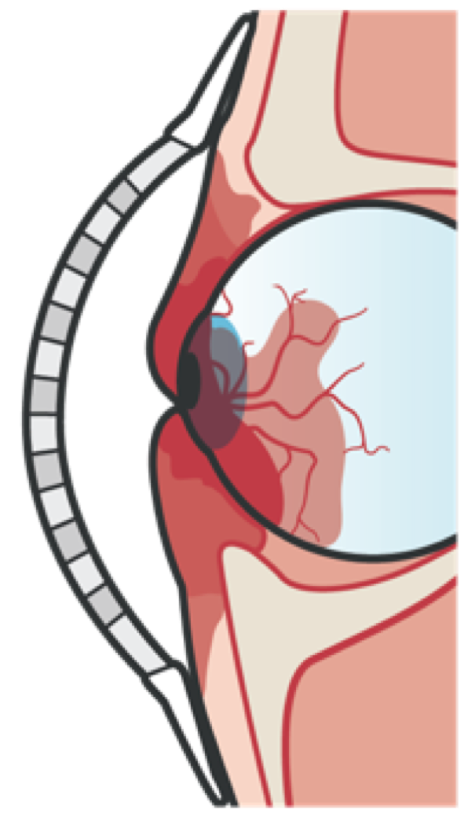

EYE INJURIES
PROTECTING THE EYE
IMPORTANT!
DO NOT APPLY PRESSURE
Avoid/prevent manipulation or additional trauma to the eye that might cause further damage
Pressure on the eye could force the interior contents of the eye out of the eyeball through a cut or laceration
Rigid Eye Shield
Apply a rigid eye shield
When penetrating eye trauma due to shrapnel is
suspected, it is critically important to prevent manipulation or additional trauma to the eye that might cause further damage to the eye

Slide 10
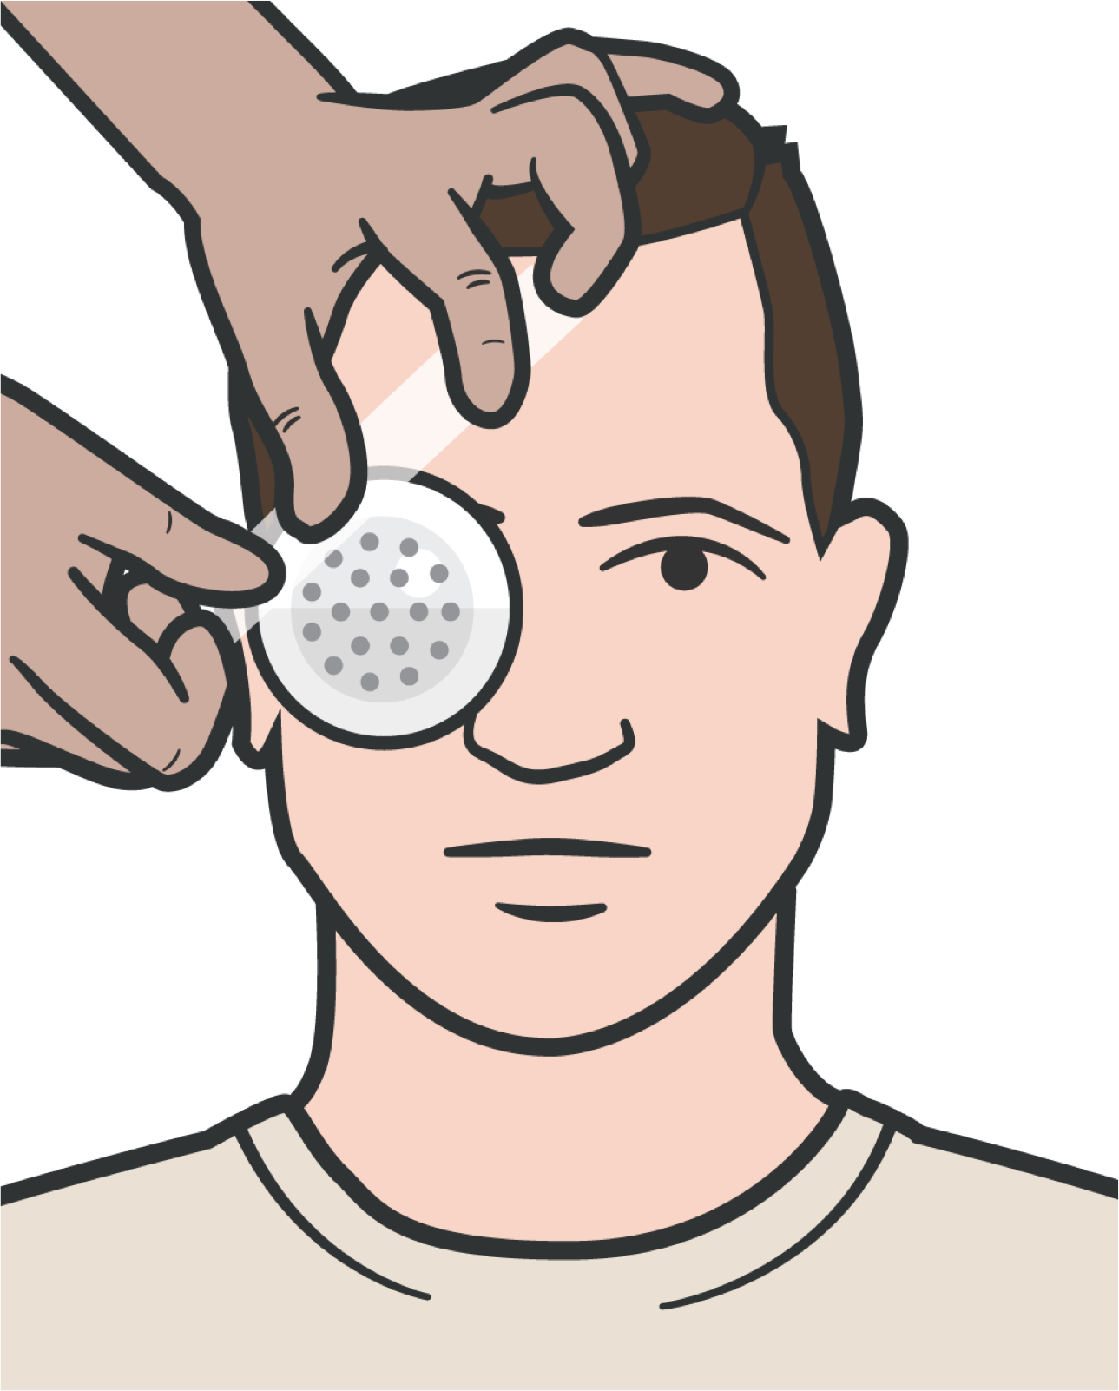
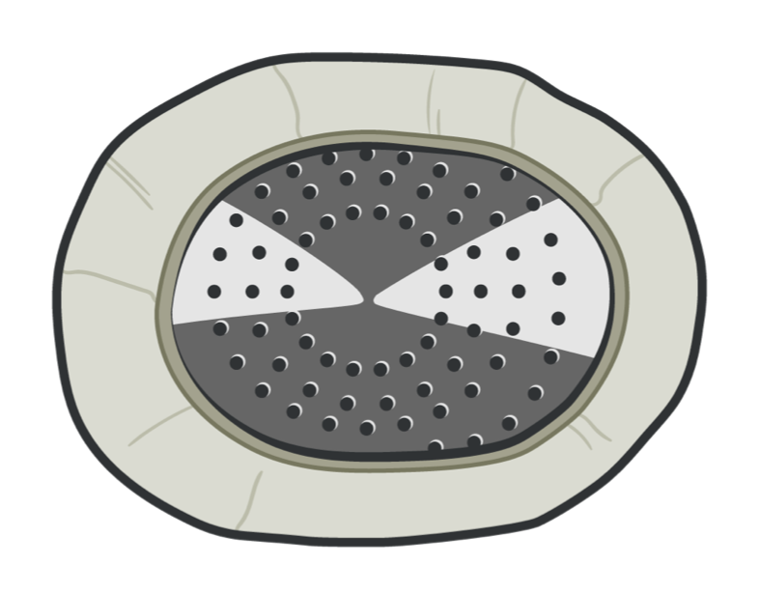
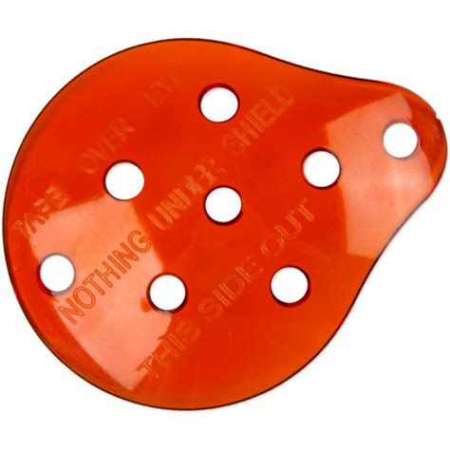
EYE INJURIES
APPLYING RIGID EYE SHIELD
The rigid eye shield is found in JFAK; if eye shield is not available, use casualty's tactical eyewear to protect
the injured eye
Secure the rigid eye shield with tape at 45-degree angles across the forehead and cheek
REMEMBER
Rigid eye shields should be placed over both eyes only when you are sure or at least strongly suspect that both eyes have been injured
If the casualty is conscious, ensure administration of the complete CWMP
▪
Do NOT cover both eyes unless both eyes are injured

Slide 11
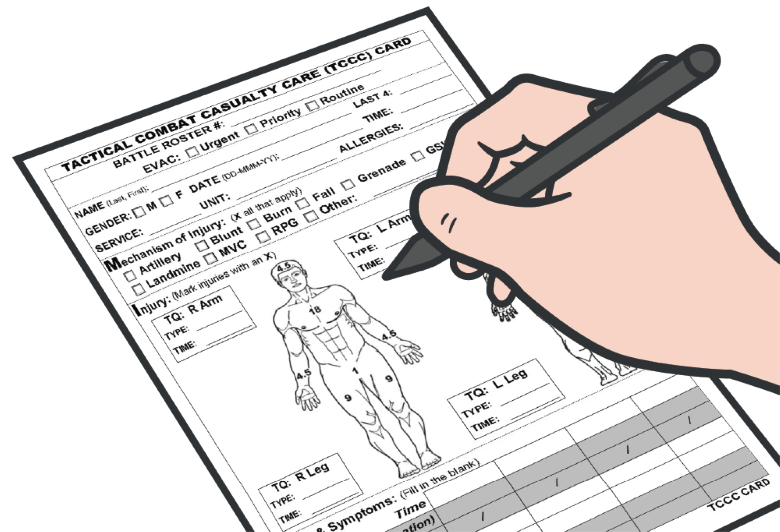
EYE INJURIES
DOCUMENT TREATMENT
Document all assessments and treatment on the DD Form 1380
Be sure to include any medications administered and the time administered

Slide 12
APPLICATION
APPLYING THE RIGID EYE SHIELD

Slide 13
EYE INJURIES
SKILL STATION
Rigid Eye Shield (Skill) Rigid Eye Shield

Slide 14


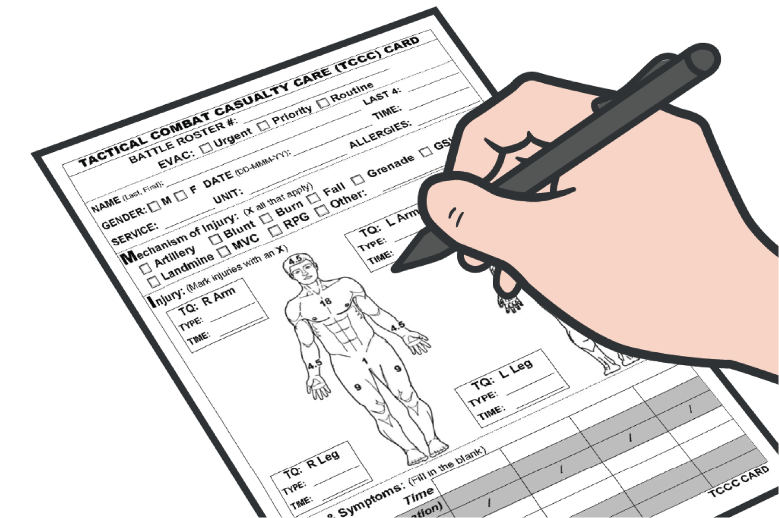
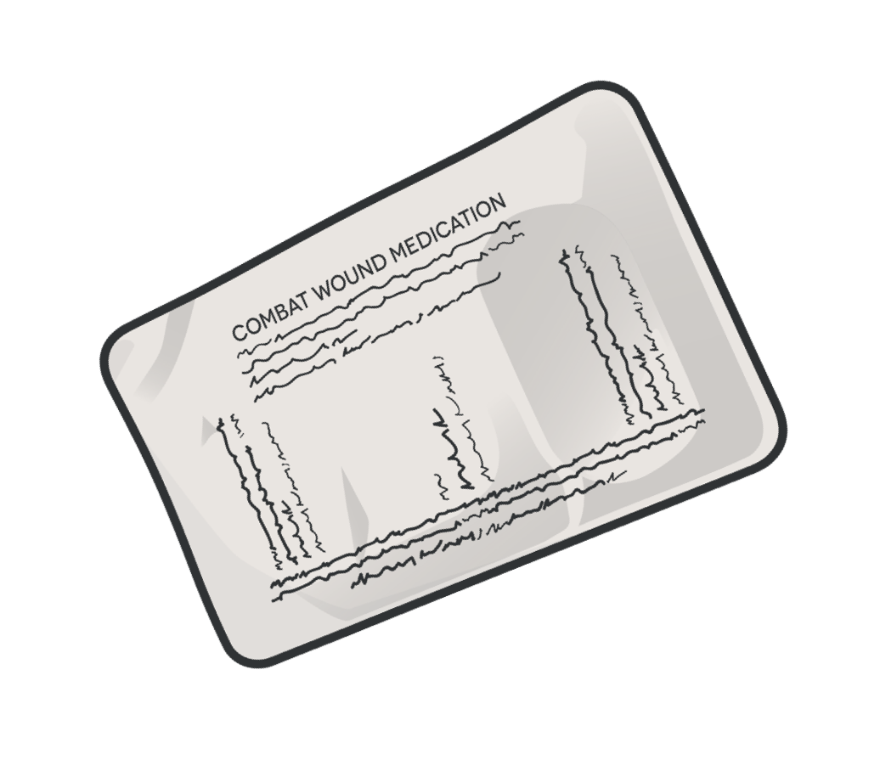
EYE INJURIES
SUMMARY
We identified eye injuries
We discussed eye injury treatment
We discussed applying an eye shield
We discussed documentation

Slide 15
EYE INJURIES
CHECK ON LEARNING
What kind of dressing should be used on penetrating eye trauma with an impaled object?
True or False: Protecting the injured eye with an eye shield is just as safe as using a patch or a pressure dressing.
True or False: Only the injured eye should be covered with an eye shield.

Slide 16
EYE INJURIES
ANY QUESTIONS?

